Slide 1


Enhancing Brain Tumor Detection in MRI Images Using Transfer Learning-Based CNN
2ND INTERNATIONAL CONFERENCE ON DATA DRIVEN AI (ICDDA 2025)
7-9 May, 2025
<<ICDDA25AB02083>>
Presented by
<<JEET MAJUMDER>>
<<Brainware University / Department of CSE, Brainware University, West Bengal, India>>
<<08-05-2025>>
<<Online Session 3.2>>

Slide 2
1
Abstract
2
Introduction & Objectives
3
Proposed Work
Table of Contents
4
Workflow Diagram
5
Methodology
6
Results & Discussion
7
Conclusion

Slide 3
ABSTRACT
This study represents a CNN-based model using a fine-tuned VGG16 architecture for categorizing brain tumors from MRI images. It had achieved a high validation accuracy of 98.67% across four categories: glioma, meningioma, pituitary, and no tumor. The model’s performance is improved by using fully connected layers with dropout, batch normalization, and the help of efficient model training. This method shows strong potential for medical application in early, non-invasive brain tumor detection
OUR PAPER
Our model achieves over 98.67% accuracy in classifying brain tumors.
Transfer-learning and fine-tuning enhance performance metrics.
Efficient hyperparameter tuning enhances the model for better generalization.

Slide 4
INTRODUCTION
Two factors contribute to brain cancer: one is the increasing incidence rate, which rises daily. The other factor is the mortality rate, which measures the frequency of deaths in a specific population over a certain period, typically expressed per 1,000 or 100,000 individuals per year. Also, image identification is critical for medical diagnostics for its ability to detect abnormalities, ensuring consistent results. Here, Machine Learning (ML) and Deep Learning (DL) provide a convenient step to learn patterns from data and provide a reliable outcome.
OBJECTIVES
Early Cancer Detection
Cancer Detection Assessment
Automated Image Categorization

Slide 5
PROPOSED WORK
Our dataset consists of four categories of brain tumors: glioma, meningioma, pituitary, and no tumor. The number of images for each category is as follows:
Cancer Types | Training Images | Testing Images | Validation Images
Glioma | 1140 | 253 | 228
Meningioma | 1177 | 230 | 238
Pituitary | 1198 | 275 | 284
No Tumor | 1401 | 296 | 303
To improve the model's performance in terms of accuracy, precision, recall, and F1 score, we use the VGG16 architecture for training. This helps enhance the classification of brain tumors across the dataset

Slide 6
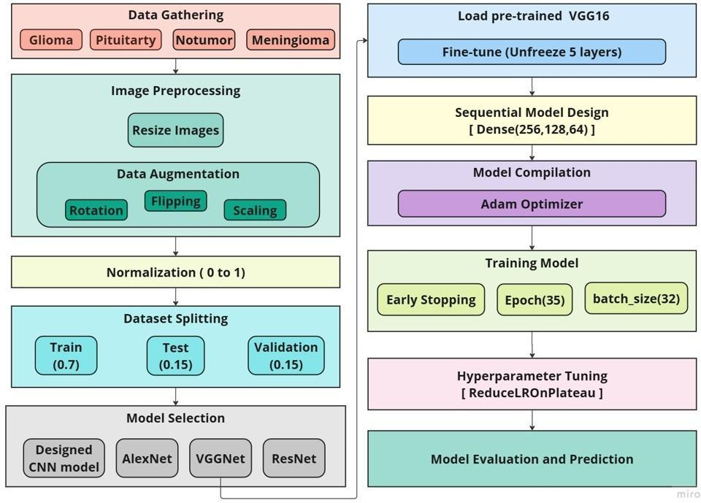
WORKFLOW

Slide 7
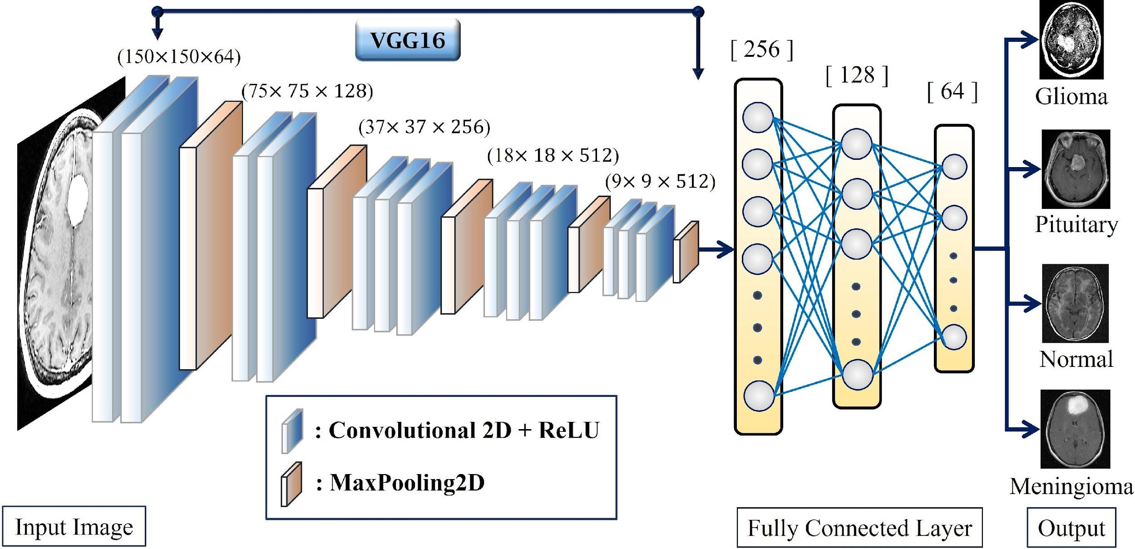
METHODOLOGY
Figure: Working Mechanism of our Proposed Framework

Slide 8
METHODOLOGY
Model training is also a very crucial step. In our case, we use a Learning rate scheduler, Early stopping, and Model checkpoints that help our model learn the patterns from MRI images and allow the model to reach the global minima.
ReduceLROnPlateau is used as a learning rate scheduler. Initially, the learning rate is 0.001, then after the patience value (3), it starts to reduce the learning rate and applies a proper momentum to learn the patterns and reduce the loss.
EarlyStopping is used to monitor validation loss and stop the learning process after 15 iterations, which we use as a patience level for our model.

Slide 9
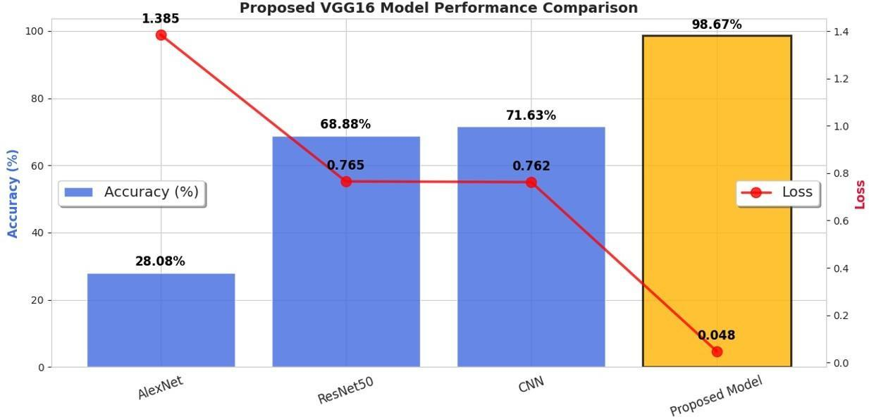
RESULTS & DISCUSSION
Proposed model accuracy and loss comparison

Slide 10
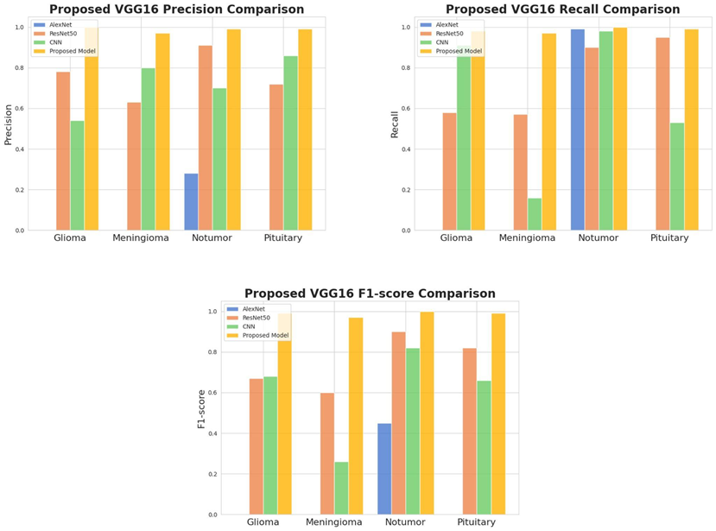
RESULTS & DISCUSSION
Proposed model precision, recall, and f1-score comparison

Slide 11
CONCLUSION
This project showcases the power of deep learning in healthcare, achieving over 98.67% accuracy in brain tumor detection using Convolutional Neural Networks (CNNs) and transfer learning. We enhanced tumor detection reliability by combining advanced image processing, high-quality datasets, and fine-tuning pre-trained models. The results highlight AI's potential to improve early detection, enabling timely treatment and better survival rates for brain tumor patients. This marks a significant step toward integrating AI into medical diagnostics for improved patient outcomes.

Slide 12
REFERENCES
[1] H.-W. Zhang, X.-L. Liu, H.-B. Zhang, et al., “Differentiation of meningiomas and gliomas by amide proton transfer imaging: A preliminary study of brain tumour infiltration,” Frontiers in Oncology, vol. 12, p. 886 968, 2022.
[2] T. N. Seyfried and L. C. Huysentruyt, “On the origin of cancer metastasis,” Critical Reviews™ in Oncogenesis, vol. 18, no. 1-2, 2013.
[3] R. L. Siegel, A. N. Giaquinto, and A. Jemal, “Cancer statistics, 2024,” CA: a cancer journal for clinicians, vol. 74, no. 1, pp. 12–49, 2024.
[4] J. R. Farwell, G. J. Dohrmann, and J. T. Flannery, “Central nervous system tumors in children cns tumors in children,” Cancer, vol. 40, no. 6, pp. 3123–3132, 1977.
[5] V. P. Grover, J. M. Tognarelli, M. M. Crossey, I. J. Cox, S. D. Taylor-Robinson, and M. J. McPhail, “Magnetic resonance imaging: Principles and techniques: Lessons for clinicians,” Journal of clinical and experimental hepatology, vol. 5, no. 3, pp. 246–255, 2015.
[6] Zeng, Yu. "Enhancing Image Classification Accuracy Based on AlexNet." Highlights in Science, Engineering and Technology 85 (2024): 879-885..

Slide 13
THANK YOU

